Slide 1

Australian Pride versus Indian golden run
Aniket Chakraborty
Date: 25th November 2023

Slide 2

Executive Summary
Introduction
Methodology
Results
Conclusion
Appendix
Outline:

Slide 3

Executive Summary
Summary of Methodologies
Data Collection for Web and Spreadsheet Organization
Basic Data Exploration Using Python
Data Manipulation using Python
Data Analysis Using SQL
Data Visualization with Python
Interactive Dashboard Creation Using Tableau
Mark Stadiums Using Python Folium
Summary of All Results
EDA Results (Exploration, Manipulation, Data Viz)
Tableau Results
Folium Results

Slide 4
Introduction
Project Background and Context
Cricket World Cup is a famous sport event that is conducted by ICC every 4 years. The first time it was conducted in 1975 in England, won by West Indies. In 1987, for the first time, it started to occur outside England. India first won this title in 1983 (Kapil Dev) and in later in 2011 (MS Dhoni). Till now Australia has won it six times. Think this project as a business problem. The journalists that are interested in the findings to write a descriptive edit in their respective news papers and Magazines. This year, World Cup was held by India across 10 stadiums and 10 cities. Australia won the world cup on 19th November. The Journey of India seems to be golden, as they were undefeated in 10 matches.
Problems That Need Answer
What factors help India to become runners up this world cup?
The interaction between different variables that make Australia 6th time winner.
Contribution of Runs and Wickets for Continents and Countries.
How bowler’s economy affect the game?
Which Cities conducted 48 matches in this world cup?

Slide 5
SECTION - 1
Methodology Associated in The Project

Slide 6
Methodology
Data Collection Methodology
From where data is collected
Now the data is organized
Data Exploration Methodology
Deals with basic data exploration methods
Data Manipulation methodology
Data pre-processing, wrangling, cleaning stage
Data Analysis with SQL
Efficient data fetching and calculation by SQL
Data Visualization with Python
Using Pandas, Numpy and Matplotlib to build effective visualizations
Interactive Tableau Visualization
Using Tableau to build effective interactive dashboards
Mark Stadiums Using Python Folium
Using Folium to Mark the Stadiums on India Map

Slide 7
Data Collection
Data Collection Steps that are adapted in the project:
As this is famous sport the data is available online.
Here I use ICC website to collect the data.
To go to the website, Click Here
After data is collected, the question is how to store the data.
Here I use Excel, a well-known spreadsheet application.
This helps me to organize the data is a tabular way.
As per my requirement, I converted the data into .csv format.
To check the .csv format data, Click Here

Slide 8
Data Wrangling
Steps taken in this process includes –
Identify missing values and replacing them with zero.
Dropping some columns to make the data small and easy to handle.
Converting some int and float type columns to object type column.
Rename the columns as required.
To get the Data Wrangling Notebook, Click Here
To get the Wrangled data set, Click Here

Slide 9
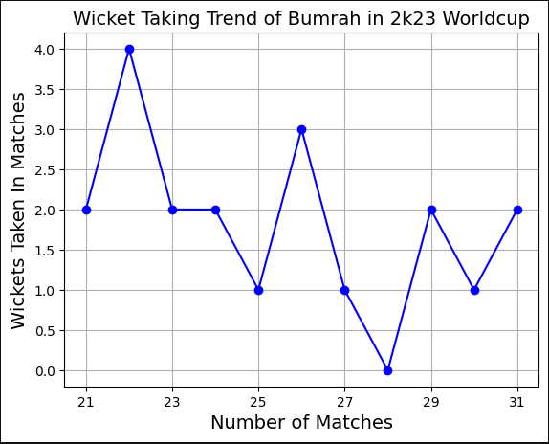
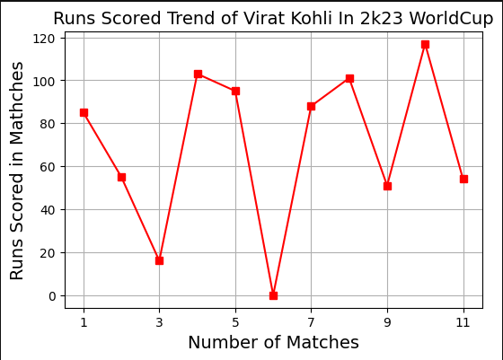
EDA With Data Visualization
In this step, I use python to plot the performance graph of different players like Virat Kohli, Rohit Sharma, Jasprit Bumrah and Adam Zampa. Along with this, I use a pie chart to represent the percentage contribute of Runs by Each Country and Each continent.
To get the Data Visualization Notebook, Click Here

Slide 10
EDA With SQL
Here I use the SQLite3 Module of Python and its Main Memory Storage to run SQL queries on the data set. To do this, connecting Google Colab and SQLite3 database is required. I use the table name ‘WORLDCUP’ for ease of use.
To get the SQL Data Analysis Notebook, Click Here
Questions to Answer with SQL are –
How many countries participated?
Who are the top 5 highest run scorers?
Who are the top 5 highest wicket taker?
Bowlers with best economies after bowling at-least 50 overs?
Top 5 players with best average runs scored in matches.
Total runs score and Total Wickets taken in this tournament.
Runs and Wickets by each type of player

Slide 11

Interactive Map Building With Folium
Here, I build an interactive map with Folium.
I mark all the stadiums that host the 48 matches.
It contains 10 different stadiums across 10 cities.
I use the Folium Marker method to mark them in red color.
Here, I also mention the city names in the interactive map.
To get the Map notebook, Click Here

Slide 12

Interactive Dashboard Using Tableau
I built an interactive dashboard with Tableau Public.
Bar graph to know the wickets taken per country.
Box plot to know the distribution of runs scored.
Box plot of runs conceded by players.
Scatter plot for the relation b/w Overs bowled, runs conceded.
Scatter plot to view relationship b/w Overs bowled, Economy.
To get the pictures, Click Here
To get the interactive dashboard, Click Here

Slide 13

Results
Data Exploration Results
Data Manipulation Results
Data Analysis with SQL Results
Data Viz with Python Results
Interactive Dashboard Results
Folium Interactive Map Building Results

Slide 14
SECTION - 2
Insights Drawn From Exploratory Data Analysis

Slide 15
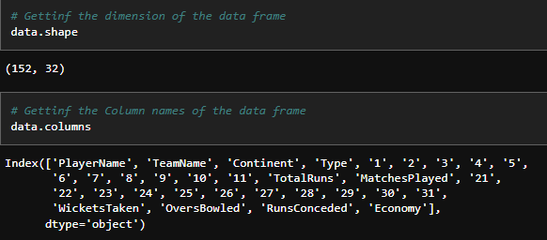
Dimension and Columns
To get the Dimension and Column names I use the .shape and .columns methods with the name of the dataframe. In the data, there are 152 rows and 32 columns. All 32 column names can be shown in a list format using the .columns method.

Slide 16
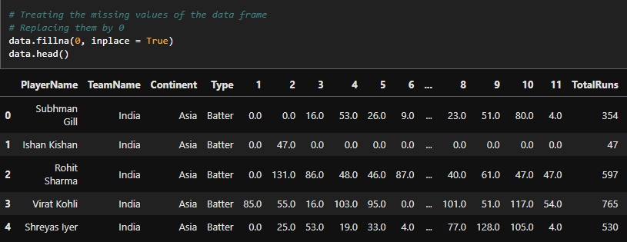
Treating Missing Values
In Python, isnull().sum() is used to get missing values that are contained in each columns. My data set also contain missing values in various columns. To treat them, I replace them with 0. The .fillna(0, inplace = True) is used to do the treatment. The values that are 0 in picture are actually Nan values in original data.

Slide 17
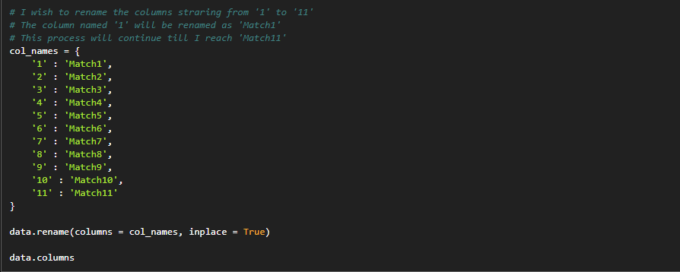
Renaming Columns
To rename columns of a dataframe .rename() of pandas function is used. It takes the names of the columns to be changed. As, number of columns is greater than 5, so I use an advanced method to make a dictionary and then pass it through the .rename() function with inplace true parameter.

Slide 18
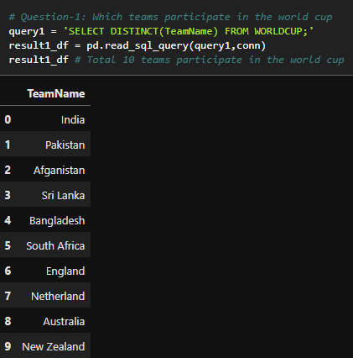
Teams Participated In WorldCup 2K23
Using SQL, I can fetch the data that shows the teams that participate in world cup 2k23. The teams are – India, Pakistan, Afghanistan, Sri Lanka, Bangladesh, South Africa, England, Netherland, Australia and New Zealand

Slide 19
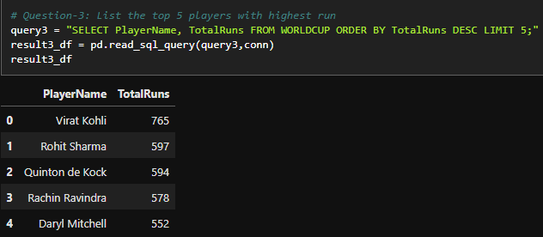
Top 5 Run Scorers
In this world cup 2k23, Virat Kohli is the highest run scorer. He Scored 9 hundreds and 3 Centuries. He crosses the record of the great Sachin Tendulkar in Number of ODI hundreds. After Virat Kohli, Rohit Sharma, Quinton de Kock, Rachin Ravindra and Daryl Mitchell are the rest 4 top run scorers.

Slide 20
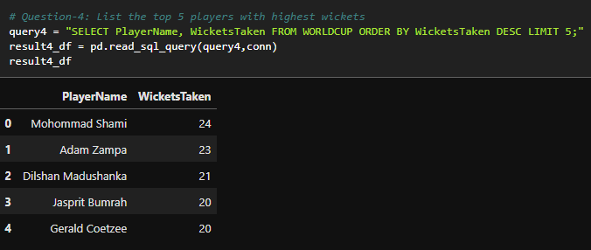
Top 5 Wicket Takers
In the world cup 2k23, Mohommad Shami takes highest Number of wickets (24) in total 11 matches. He made a record as the first Indian to take 50 world cup wickets for India by playing lowest number of matches. After him, Australian Adam Zampa, Sri Lankan Madushanka, Indian Jasprit Bumrah and South African Coetzee are the rest 4 in the list.

Slide 21
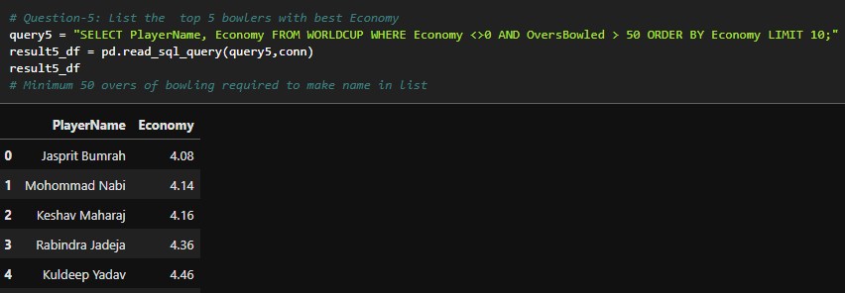
Top 5 Bowlers With Best Economy
In world cup 2k23, Jasprit Bumrah is the bowler, having the best economy of 4.08 after bowling approximately 98 overs. This is the best bowling average in Indians. After him, Ravindra Jadeja and Kuldeep Yadav are the other two Indian Bowlers. South African Keshav Maharaj and Afghani Mohommad Nabi are on the list.

Slide 22
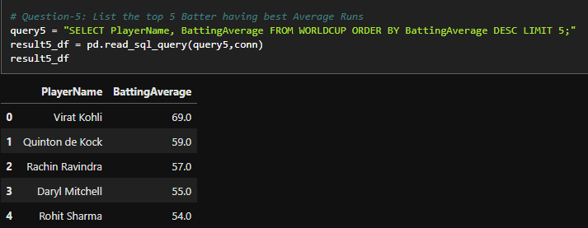
Top 5 Batters With Best Average
In world cup 2k23, Virat Kohli Made 765 runs in 11 matches. As he had the highest runs in 11 matches, so Virat Kohli has the highest Average, approximately 69. Quinton de Kock, Daryl Michell, Rachin Ravindra and Rohit Sharma are also on the list. Lowest Average is of Rohit Sharma as he made 597 runs in 11 matches. Other three played 9 matches.

Slide 23
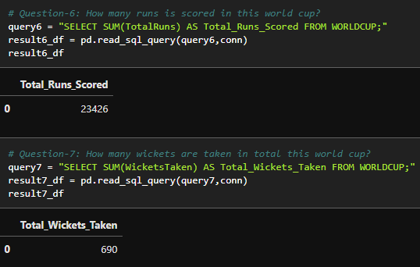
Total Runs and Wickets In WorldCup
In this world cup 2k23, Total 23426 runs are made by 10 countries. Whereas Total wickets taken by 10 countries are 690.

Slide 24
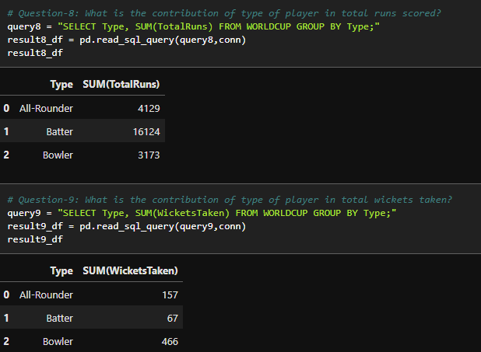
Runs and Wickets By Each Player Type
In Cricket, there are mainly three types of Players. Batters (they bat only), bowlers (they bowl only) and all-rounders (they bat and bowl). The third type is more versatile. As a result, they are the backbones on any team.

Slide 25
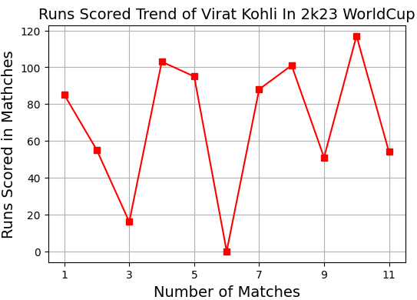
Virat Kohli Performance Graph
In world cup 2k23, Virat Kohli played total 11 innings. Out of them he scored a duck in game number 6 (against England). He scored highest run 117 in game number 10 (against New Zealand). He scored only a less 50 runs in game number 2 (against Pakistan) as the graph depicts.

Slide 26
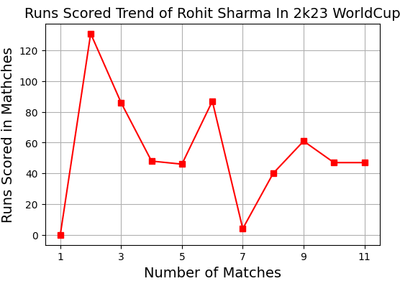
Rohit Sharma Performance Graph
In world cup 2k23, Rohit Sharma played total 11 innings. Out of them he scored a duck in game number 1 (against Australia) and scored 4 in game number 7 (against Sri Lanka). He scored highest run 131 in game number 2 (against Afghanistan). He scored many less than 50 runs but all of them gave India a good start in Power play as the graph depicts.

Slide 27
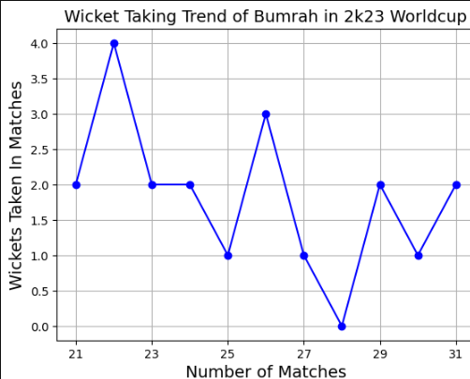
Jasprit Bumrah Performance Graph
In world cup 2k23, Jasprit Bumrah played total 11 innings. He takes 4 wickets in game number 2 (against Afghanistan). He has only a game without a wicket less game in game number 8 in world cup (against South Africa). His bowling economy is the best throughout this world cup. He takes total 20 wickets, as the graph suggests.

Slide 28
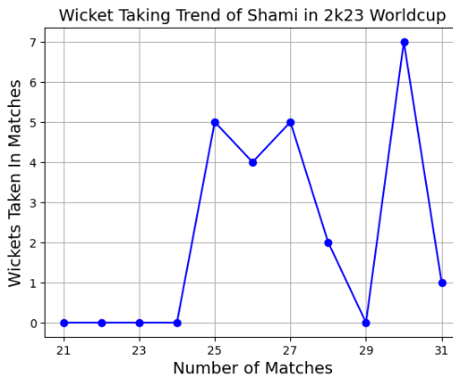
MH. Shami Performance Graph
In world cup 2k23, Mohommad Shami played Total 7 games. He starts his world cup campaign with a fifer in game number 5 (against New Zealand). He manages to achieve 3 fifers (5 wickets hall) in important games, one of them was Semi-final. He made a record as an Indian to take 50 world cup wickets in lowest number of games. He is the highest wicket taker of the tournament (with 24 wickets) as the graph depicts.

Slide 29
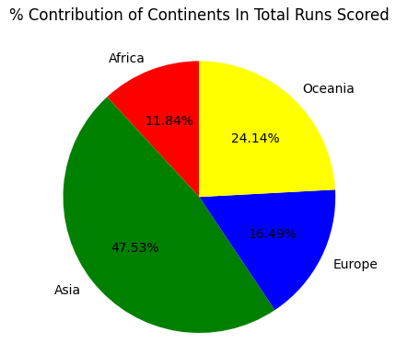
Contribution of Continents in Runs
In world cup 2k23, total 23426 runs are scored by 10 countries, across 4 continents. Out of the total runs scored, approximately 47.53% of runs are scored by Asian Countries (India, Pakistan, Bangladesh, Sri Lanka, Afghanistan). Approximately 11.84% runs are scored by African countries (South Africa). Approximately 16.49% of runs are scored by European countries (England and Nederland). Lastly 24.14% of runs are scored by Oceanian countries (Australia and New Zealand). One thing to observe that Asia participates very much as number of Asian countries are highest in the world cup.

Slide 30
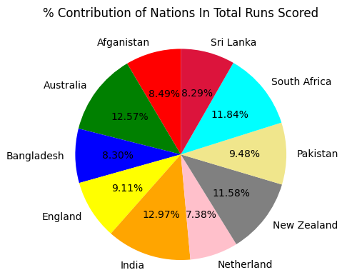
Contribution of Nations in Runs
In world cup 2k23, total 23426 runs are scored by 10 countries, across 4 continents. Out of the total runs scored, approximately, 12.97% runs are scored by India, 12.57% runs are scored by Australia, 11.58% runs are scored by New Zealand and 8.29% runs are scored by South Africa, 9.48% runs are scored by Pakistan. They are major first 5 contributing countries in total runs scored in World Cup 2k23.

Slide 31
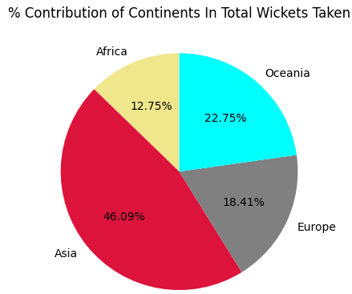
Contribution of Continents in Wickets
In world cup 2k23, total 690 wickets are taken by 10 countries, across 4 continents. Out of the total wickets taken , approximately, 46.09% wickets are taken by Asia. Approximately 12.75% wickets are taken by Africa. Approximately 22.75% wickets are taken by Oceania. Approximately 18.41% wickets are taken by Europe. One thing to observe that Asia contributes very much in this. One reason behind this may be number of Asian countries are high that participate in this world cup.

Slide 32
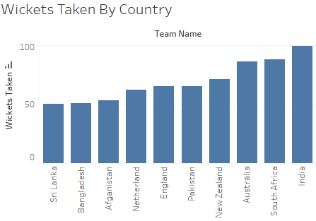
Wickets Taken By Each Country
In world cup 2k23, total 690 wickets are taken by 10 countries, across 4 continents. India is the country that takes the highest number of wickets. After India there are South Africa, Australia and New Zealand. So, this is evident from the graph that why these four teams are the four finalist of these World cup.

Slide 33
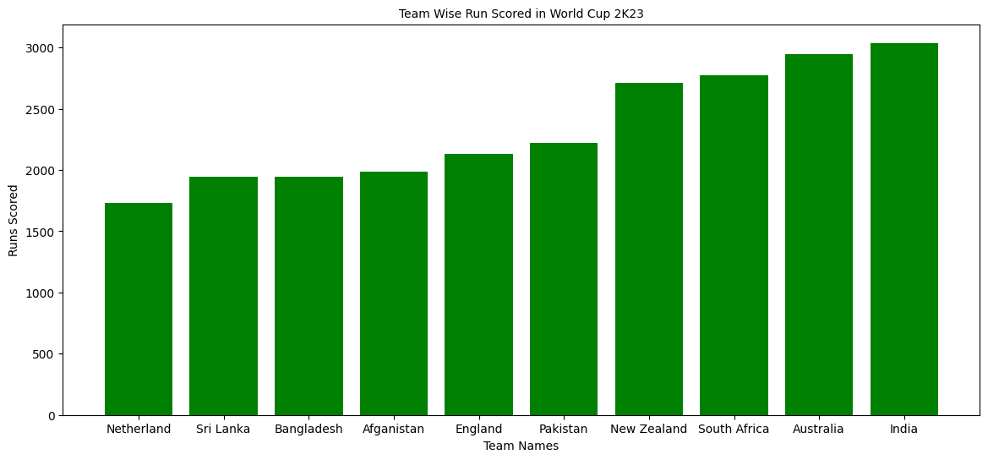
Team Wise Run Scored In World Cup 2K23
In world cup 2k23, total 10 teams participated. As per the bar chart, top 4 teams that have highest run scored are – India, Australia, New Zealand and South Africa. From the wickets perspective also, these four teams are top 4. These are the reasons why these 4 teams played knockout matches.
It also confirms why India and Australia played final as most deserved team in the tournament.

Slide 34
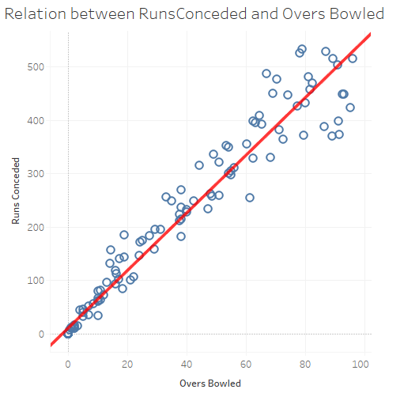
Relation Between Overs Bowled & Runs Conceded
In world cup 2k23, total 23426 runs are scored. It is a generalized fact that higher overs are bowled will increase the chance of higher runs conceded. The same is reflected from the graph. The graph also shows a red trend line that shows the strictly increasing relationship between the two variables.
Scatter plot is used here as the two variables that are compared is continuous type. Use of Tableau makes it easier to plot the interactive visualizations.

Slide 35
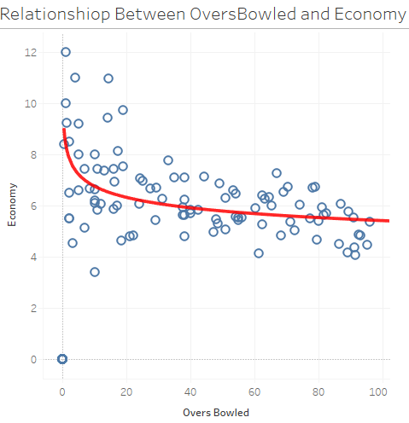
Relation Between Overs Bowled & Bowlers Economy
In world cup 2k23, total 23426 runs are scored. A bowler's economy is a metric used to interpret bowler’s performance in the tournament. It is measured by runs conceded per Overs. The two variables are not related directly or inversely. For example, Bumrah bowled approx. 98 overs and still his economy is around 4.08.
Scatter plot is used to plot the relation between these two continuous variables. Tableau is used to plot these interactive graphs.

Slide 36
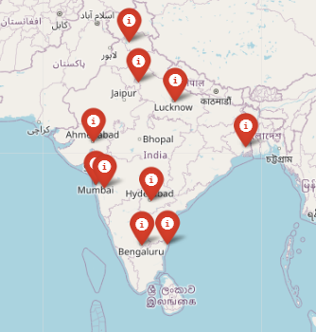
Marking Stadiums of World Cup 2K23 In Indian Map Using Folium
In world cup 2k23, total 48 matches are arranged across 10 cities and in 10 different stadiums. These cities are – Kolkata, Ahmedabad, Delhi, Mumbai, Pune, Chennai, Bangaluru, Lucknow, Dharamsala and Hyderabad.
The final was played in Narendra Modi Stadium, Ahmedabad. The second Semi – final was played in Eden Gardens, Kolkata.

Slide 37

Conclusions
In Bat and bowling aspect, India, Australia, South Africa and New Zealand dominate rest teams.
India and Australia are those most deserved teams as they are first and Second in Batting and Bowling aspect.
Asia Continent dominates the world from Batting and Bowling aspect.
Virat Kohli is the highest run getter in this world cup.
Mohommad Shami is the highest wicket taker.
Jasprit Bumrah has the best Economy.
No certain relationship between overs bowled and Economy. It depends on player skill.

Slide 38
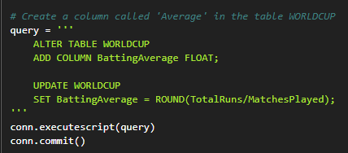
Appendix
I fetch the information on the best batting average of players. I found it is Virat Kohli. One thing to note that there is no such column in the Table . So, I create a column called Average and add the column in the table by defining the column type and by setting its value. To do this .executeScript() method is used. After that I use Commit Statement.
To close the connection, conn.close() is used.

Slide 39

Other Links to Follow
GitHub Profile Link: Click Here
The Project Notebooks Link: Click Here
Email Id to Contact: Click Here
LinkedIn Id to Contact: Click Here
Portfolio Link: Click Here

Slide 40

Thank You

